Slide 1

GG Team
Yaodong Wang
Siyu Liu
Yang Li
Yaoye Lu

Slide 2
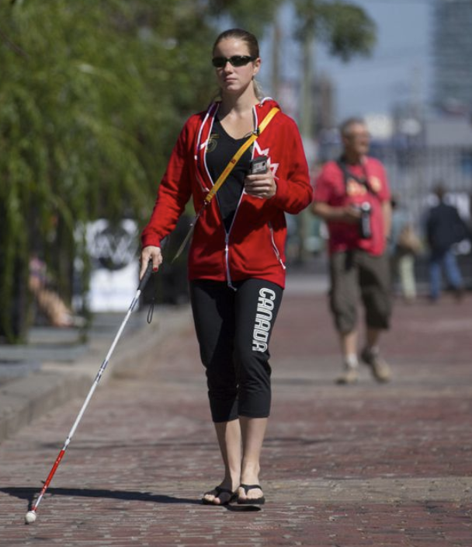
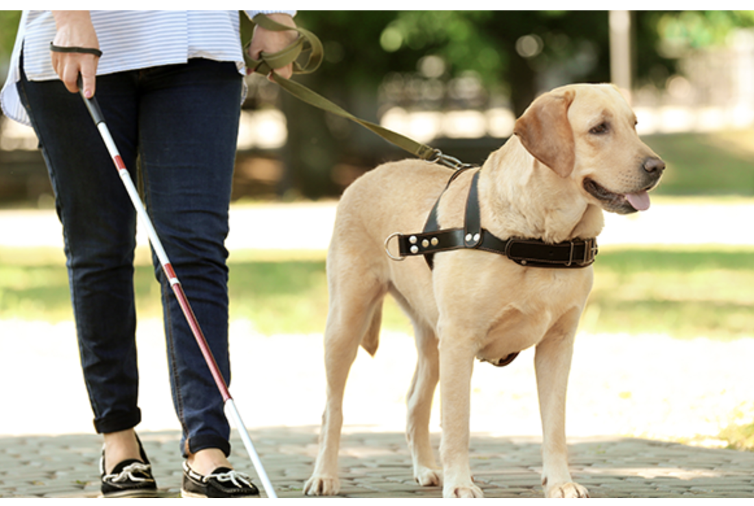
Background
https://www.thestar.com/news/gta/2015/08/13/virtual-vision-system-is-a-boost-for-blind-independence.html
https://probonoaustralia.com.au/news/2019/05/guide-dogs-business-venture-set-to-shake-up-traditional-charity-model/

Slide 3

Realistic Problems with Guide dogs
$35,000 /guide dog (the whole life need 3-4)
Long term cost for feeding
Expensive cost
Training for around 1.5-2 years
Accompany for 8-10 years
Time cost
Dog may get sick or die
People can be allergic to dogs
Others…
Realistic Problem

Slide 4
Target Customer
Individual person with vision issues
Medical instrumental companies / hospitals/ charity organisations

Slide 5
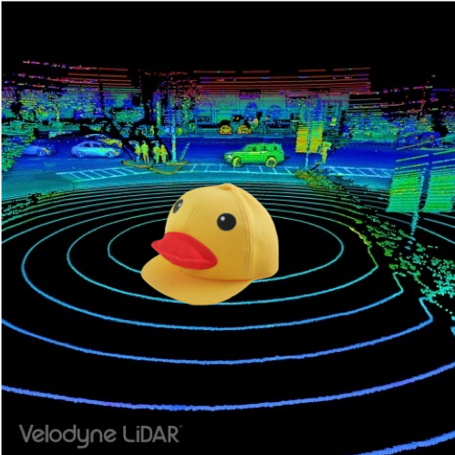
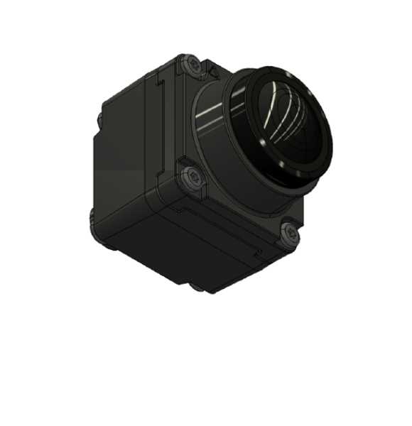
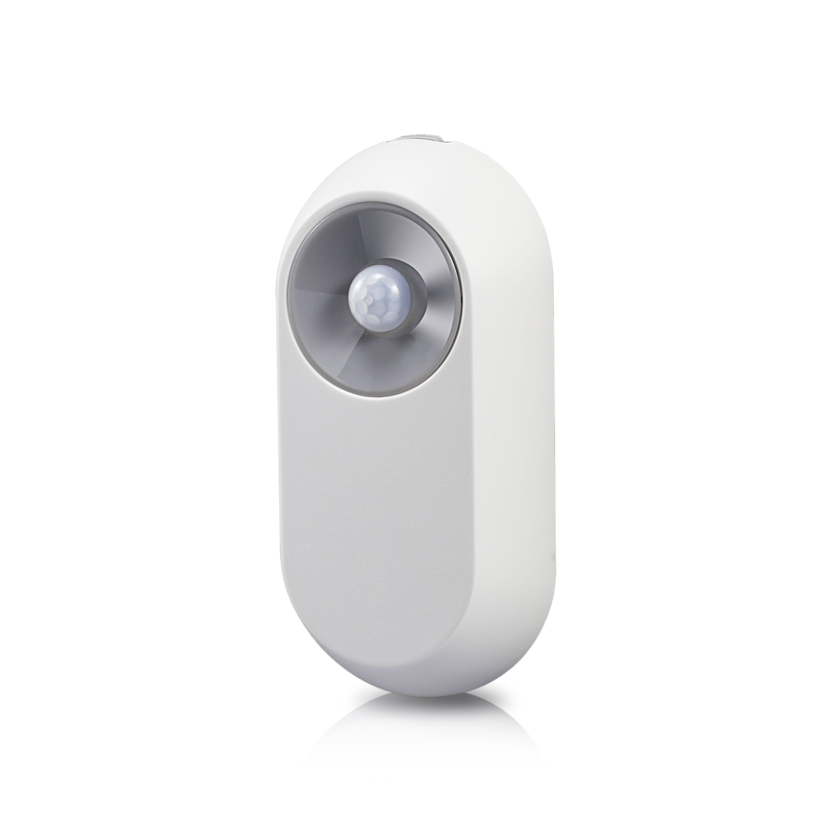

Solution — Wearable gears
Core hardwares:
Hat embedded with sensors and cameras
Microphones
Earphones
https://www.businesswire.com/news/home/20181109005344/zh-HK/

Slide 6
Cost Structure of Our Product
Hardware cost | Each equipment have 8 Infrared sensors: 8 x$10=$80 4 Mini HD cameras: 4 x $30 = $120 Processing chip: $20 Speech Recognition $20 Earphone： $50
App development | $1500
Advertise | $1000
Process | $10/each

Slide 7
Advantages of Our Product
Expense Cost
Low price
Time cost
No long time of training dogs
Controlable
Less concern about accidents
Convenience
Easy to carry

Slide 8
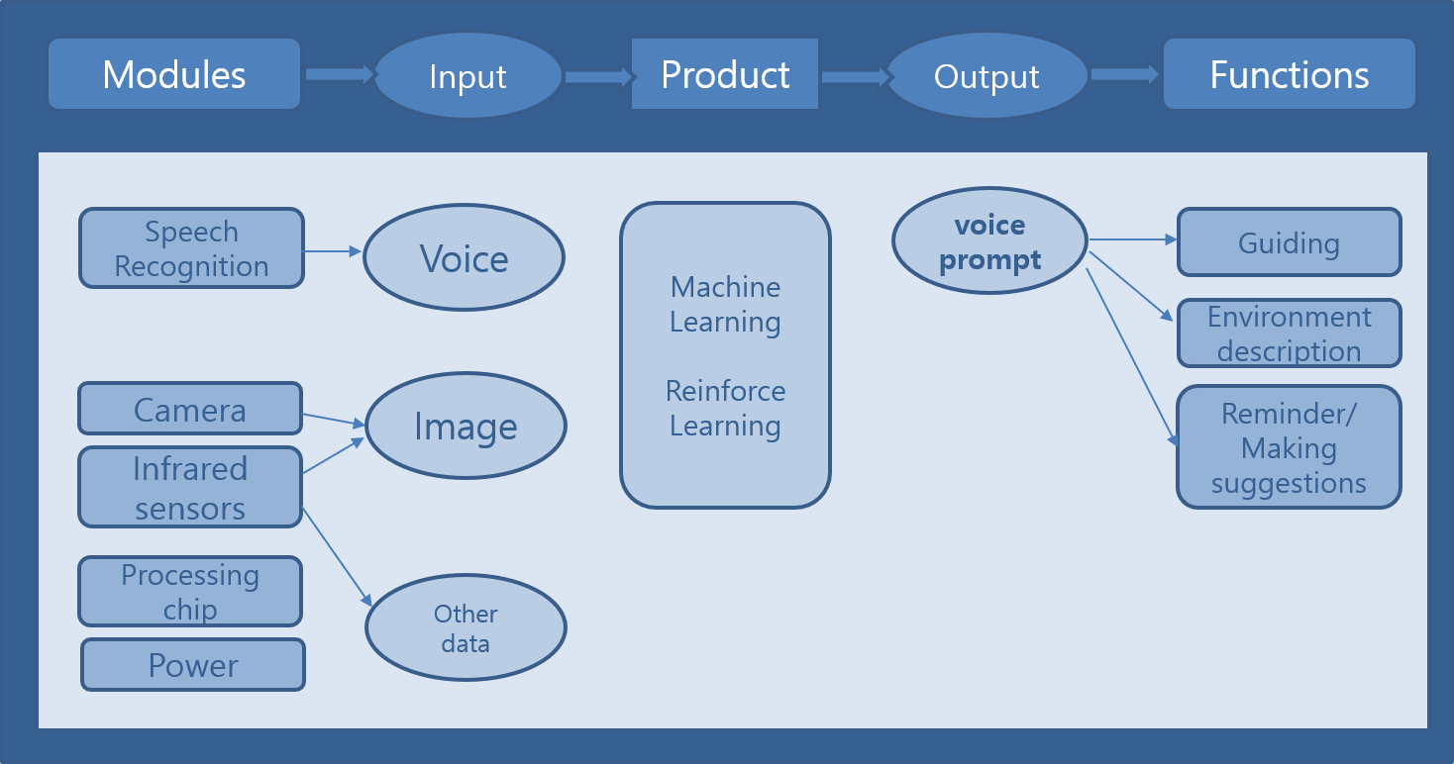
How the product works?

Slide 9
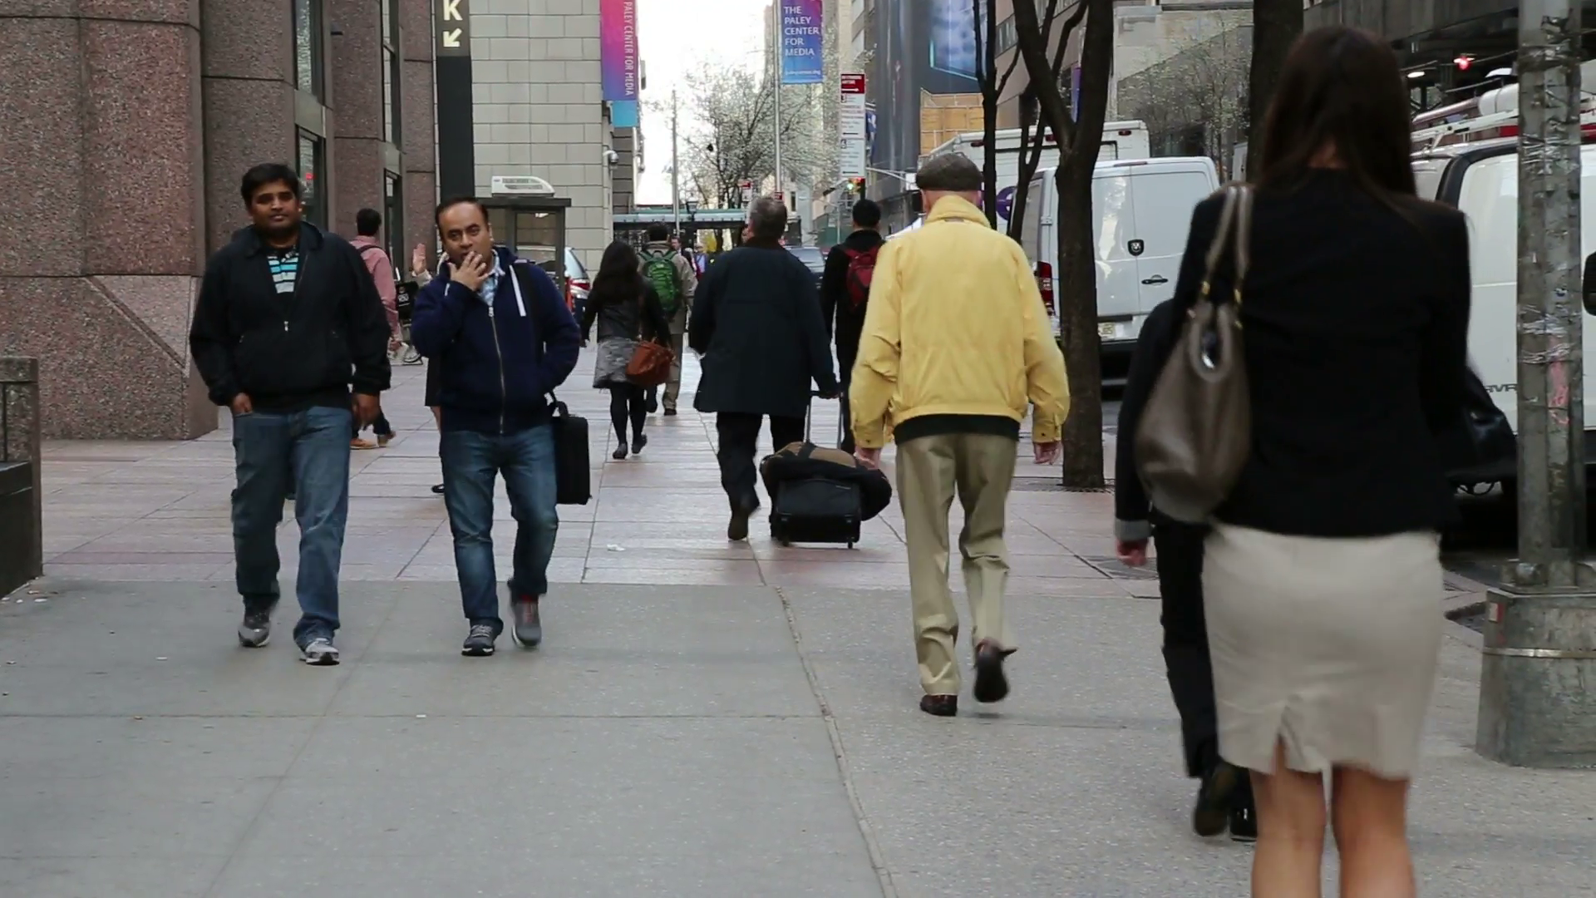
What we hope to achieve?
“ The street is about 3 meters wide. There are two man walking towards you 3 meters away, and there three people walking in front of you in your right hand side….”

Slide 10
What we have achieved today?
“ People, Pedestrian, Public space, Urban area, Walking, Snapshot, Jeans, Street, Standing, Sidewalk”
Don’t be depressed! This is a good starting point!

Slide 11
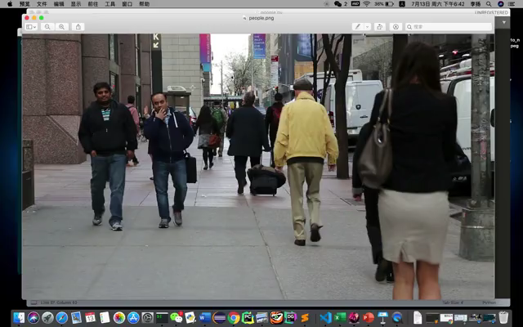
Test Demo Exhibition

Slide 12
Future Challenges
Technology
How to retrieve more details from the input data
Security
System hacking
Extreme Weather
Affect retrieval of Input data

Slide 13
THANK YOU
ALLPPT.com _ Free PowerPoint Templates, Diagrams and Charts

